Slide 1
Concurrency Control
Introduction
Problems in Concurrency Control
Concurrency Techniques/Protocols

Slide 2
Introduction
It is the method of managing concurrent operations on the database without getting any obstruction with one another.
Concurrency control in DBMS is an important concept that is related to the transactions and data consistency of the database management systems. Concurrency control refers to the process of managing independent operations of the database that are simultaneous and considered as a transaction in DBMS. Concurrency Control works on the principle of maintaining the transactions state that can be a complete transaction or an incomplete transaction. In the case of the complete transaction, all the associated database operations need to be completed with specified rules and sequences, whereas an incomplete transaction occurs in case all the database operations are not completed due to some technical, power failure, or network connectivity issue.

Slide 3
Why we need concurrency control
Without Concurrency Control, problems may occur with concurrent transactions:
Lost Update Problem (WW conflicts).
Occurs when two transactions update the same data item, but both read the same original value before update (Figure 21.3(a), next slide)
The Temporary Update (or Dirty Read) Problem (WR conflicts)
This occurs when one transaction T1 updates a database item X, which is accessed (read) by another transaction T2; then T1 fails for some reason (Figure 21.3(b)); X was (read) by T2 before its value is changed back (rolled back or UNDONE) after T1 fails

Slide 5
Why we need concurrency control (cont.)
The Incorrect Summary Problem (RW conflicts).
One transaction is calculating an aggregate summary function on a number of records (for example, sum (total) of all bank account balances) while other transactions are updating some of these records (for example, transferring a large amount between two accounts, see Figure 21.3(c)); the aggregate function may read some values before they are updated and others after they are updated.

Slide 7
Why we need concurrency control (cont.)
The Unrepeatable Read Problem (RW conflicts).
A transaction T1 may read an item (say, available seats on a flight); later, T1 may read the same item again and get a different value because another transaction T2 has updated the item (reserved seats on the flight) between the two reads by T1.

Slide 8
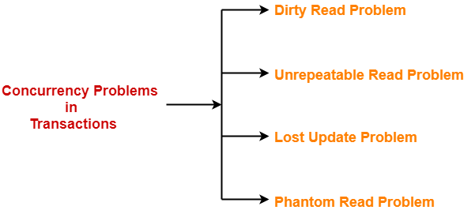
Problems in Concurrency Control
When multiple transactions execute concurrently in an uncontrolled or unrestricted manner, then it might lead to several problems.
Such problems are called as concurrency problems.

Slide 9
1. Dirty Read Problem-
Reading the data written by an uncommitted transaction is called as dirty read.
This read is called as dirty read because-
There is always a chance that the uncommitted transaction might roll back later.
Thus, uncommitted transaction might make other transactions read a value that does not even exist.
This leads to inconsistency of the database.
NOTE-
Dirty read does not lead to inconsistency always.
It becomes problematic only when the uncommitted transaction fails and roll backs later due to some reason.

Slide 10
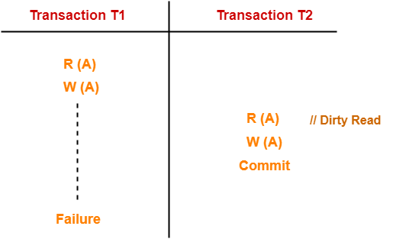
Example- Dirty Read Problem-
Here,
T1 reads the value of A.
T1 updates the value of A in the buffer.
T2 reads the value of A from the buffer.
T2 writes the updated the value of A.
T2 commits.
T1 fails in later stages and rolls back.
In this example,
T2 reads the dirty value of A written by the uncommitted transaction T1.
T1 fails in later stages and roll backs.
Thus, the value that T2 read now stands to be incorrect.
Therefore, database becomes inconsistent.

Slide 11
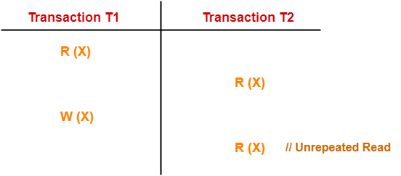
2. Unrepeatable Read Problem-
This problem occurs when a transaction gets to read unrepeated i.e. different values of the same variable in its different read operations even when it has not updated its value.
Example-
Here,
T1 reads the value of X (= 10 say).
T2 reads the value of X (= 10).
T1 updates the value of X (from 10 to 15 say) in the buffer.
T2 again reads the value of X (but = 15).
In this example,
T2 gets to read a different value of X in its second reading.
T2 wonders how the value of X got changed because according to it, it is running in isolation.

Slide 12
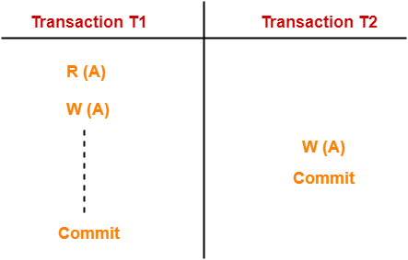
3. Lost Update Problem-
This problem occurs when multiple transactions execute concurrently and updates from one or more transactions get lost.
Here,
T1 reads the value of A (= 10 say).
T2 updates the value to A (= 15 say) in the buffer.
T2 does blind write A = 25 (write without read) in the buffer.
T2 commits.
When T1 commits, it writes A = 25 in the database.
In this example,
T1 writes the over written value of X in the database.
Thus, update from T1 gets lost.
Example-
NOTE-
This problem occurs whenever there is a write-write conflict.
In write-write conflict, there are two writes one by each transaction on the same data item without any read in the middle.

Slide 13
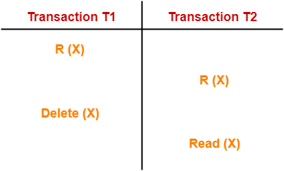
4. Phantom Read Problem-
This problem occurs when a transaction reads some variable from the buffer and when it reads the same variable later, it finds that the variable does not exist.
Example-
Here,
T1 reads X.
T2 reads X.
T1 deletes X.
T2 tries reading X but does not find it.
In this example,
T2 finds that there does not exist any variable X when it tries reading X again.
T2 wonders who deleted the variable X because according to it, it is running in isolation.

Slide 14
Concurrency Techniques/Protocols
Concurrency Control is the working concept that is required for controlling and managing the concurrent execution of database operations and thus avoiding the inconsistencies in the database. Thus, for maintaining the concurrency of the database, we have the concurrency control protocols.

Slide 15
Concurrency Control Protocols
The concurrency control protocols ensure the atomicity, consistency, isolation, durability and serializability of the concurrent execution of the database transactions. Therefore, these protocols are categorized as:
Lock Based Concurrency Control Protocol
Time Stamp Concurrency Control Protocol
Validation Based Concurrency Control Protocol

Slide 16
I. Lock Based Concurrency Control Protocol
Lock Based Protocols in DBMS is a mechanism in which a transaction cannot Read or Write the data until it acquires an appropriate lock. Lock based protocols help to eliminate the concurrency problem in DBMS for simultaneous transactions by locking or isolating a particular transaction to a single user.
A lock is a data variable which is associated with a data item. This lock signifies that operations that can be performed on the data item. Locks in DBMS help synchronize access to the database items by concurrent transactions.
All lock requests are made to the concurrency-control manager. Transactions proceed only once the lock request is granted.

Slide 17
There are two kinds of locks used in Lock-based protocols:
Binary Locks: A Binary lock on a data item can either locked or unlocked states.
Shared/exclusive: This type of locking mechanism separates the locks in DBMS based on their uses. If a lock is acquired on a data item to perform a write operation, it is called an exclusive lock.

Slide 18
1. Shared Lock (S):
A shared lock is also called a Read-only lock. With the shared lock, the data item can be shared between transactions. This is because you will never have permission to update data on the data item.
For example, consider a case where two transactions are reading the account balance of a person. The database will let them read by placing a shared lock. However, if another transaction wants to update that account’s balance, shared lock prevent it until the reading process is over.

Slide 19
2. Exclusive Lock (X):
With the Exclusive Lock, a data item can be read as well as written. This is exclusive and can’t be held concurrently on the same data item. X-lock is requested using lock-x instruction. Transactions may unlock the data item after finishing the ‘write’ operation.
For example, when a transaction needs to update the account balance of a person. You can allows this transaction by placing X lock on it. Therefore, when the second transaction wants to read or write, exclusive lock prevent this operation.

Slide 20
There are four types of lock protocols available:
1. Simplistic lock protocol
2. Pre-claiming Lock Protocol
3. Two-phase locking (2PL)
4. Strict Two-phase locking (Strict-2PL)

Slide 21
1. Simplistic lock protocol
It is the simplest way of locking the data while transaction. Simplistic lock-based protocols allow all the transactions to get the lock on the data before insert or delete or update on it. It will unlock the data item after completing the transaction.

Slide 22
2. Pre-claiming Lock Protocol
Pre-claiming Lock Protocols evaluate the transaction to list all the data items on which they need locks.
Before initiating an execution of the transaction, it requests DBMS for all the lock on all those data items.
If all the locks are granted then this protocol allows the transaction to begin. When the transaction is completed then it releases all the lock.
If all the locks are not granted then this protocol allows the transaction to rolls back and waits until all the locks are granted.

Slide 23
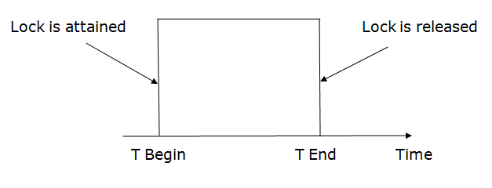

Slide 24
3. Two-phase locking (2PL)
The two-phase locking protocol divides the execution phase of the transaction into three parts.
In the first part, when the execution of the transaction starts, it seeks permission for the lock it requires.
In the second part, the transaction acquires all the locks. The third phase is started as soon as the transaction releases its first lock.
In the third phase, the transaction cannot demand any new locks. It only releases the acquired locks.

Slide 25
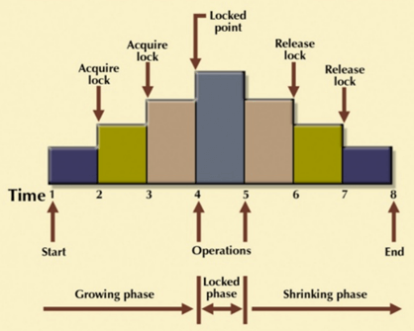
3. Two-phase locking (2PL)
The Two-Phase Locking protocol allows each transaction to make a lock or unlock request in two steps:
Growing Phase: In this phase transaction may obtain locks but may not release any locks.
Shrinking Phase: In this phase, a transaction may release locks but not obtain any new lock.
It is true that the 2PL protocol offers serializability. However, it does not ensure that deadlocks do not happen.
In the above-given diagram, you can see that local and global deadlock detectors are searching for deadlocks and solve them with resuming transactions to their initial states.

Slide 26
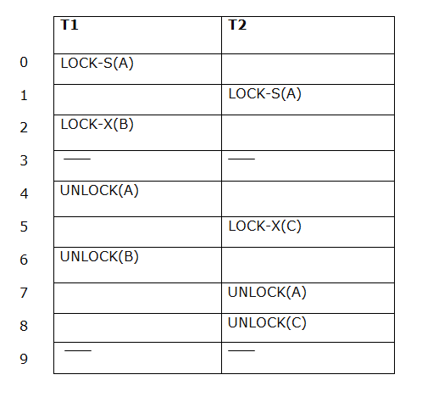
3. Two-phase locking (2PL)
If lock conversion is allowed then the following phase can happen:
Upgrading of lock (from S(a) to X (a)) is allowed in growing phase.
Downgrading of lock (from X(a) to S(a)) must be done in shrinking phase.
The following way shows how unlocking and locking work with 2-PL.
Transaction T1:
Growing phase: from step 0-2
Shrinking phase: from step 4-6
Transaction T2:
Growing phase: from step 1-5
Shrinking phase: from step 7-8

Slide 27
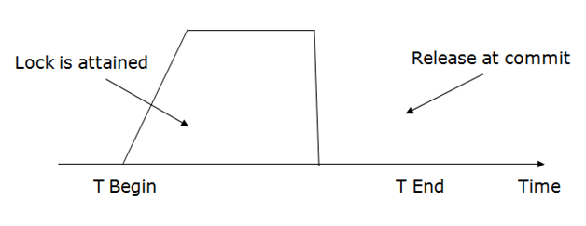
4. Strict Two-phase locking (Strict-2PL)
The first phase of Strict-2PL is similar to 2PL. In the first phase, after acquiring all the locks, the transaction continues to execute normally.
The only difference between 2PL and strict 2PL is that Strict-2PL does not release a lock after using it.
Strict-2PL waits until the whole transaction to commit, and then it releases all the locks at a time.
Strict-2PL protocol does not have shrinking phase of lock release.
It does not have cascading abort as 2PL does.

Slide 28
Static Protocol
Static (or conservative) Two Phase Locking: In this type of scheme, all the data items are locked earlier than any operations on them and are released just only after the last operation carried out on any data item.
X(X)
X (Y)
Read (X)
Write (X)
Read (Y)
Y = Y+N
Write Y
Unlock (X)
Unlock (Y)
In static 2PL, requests from other transactions for data items locked by the previous transaction will be delayed without need, so causing a serious impact on system performance.

Slide 29
Dynamic Protocol
Here a transaction locks a data item instantly earlier than any operation is applied on the data item. After finishing all the operations on all the data items, it releases all the locks. An instance of dynamic 2PL is as following :
X(X)
Read (X)
X=X+M
Write (X)
X (Y)
Read (Y)
Y=Y+N
Write Y
Unlock (Y)
Unlock (X)

Slide 30
Strict Protocol
Strict 2PL is the most restrictive form of 2PL. In strict 2PL, a transaction is not allowed to release any locks until it has reached the commit point. This means that a transaction will hold all of its locks until it has completed its execution and is ready to be committed.

Slide 31
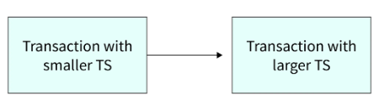
II. Timestamp Ordering Protocol
What are Timestamp Ordering Protocols?
Timestamp-based protocols in DBMS are used to order the transaction in ascending order of their creation time. The creation time is the system time or a logical counter.
The transaction which is created first or you can say older transactions are given high priority over new transactions.
For example, if there are two transactions T1 and T2. T1 enters the system at 008 and T2 enters the system at 009 then T1 is given priority over T2.

Slide 32
How a Timestamp Ordering Protocol Works?
Timestamp-based protocols in DBMS order the transaction according to their transaction timestamps. A schedule that is ordered in the serial order of their transaction timestamp is the only serializable schedule equivalent to the timestamp-ordered-based transaction schedule.
In order to ensure that the conflicting operation occurring in the schedule does not violate the timestamp ordering two-time stamp values relating to each database item (X) are used :
W_TS(X) (write timestamp) is the largest timestamp of any transaction that executed write(X) successfully.
R_TS(X) (read timestamp) is the largest timestamp of any transaction that executed read(X) successfully.

Slide 33
Basic Timestamp Ordering
When a transaction enters a system timestamp is created for the particular transaction. Suppose if the T1 transaction enters the system then it is assigned a timestamp TS(T1) and after T1 if the T2 transaction enters the system then T2 is assigned a timestamp TS(T2). According to the Timestamp ordering protocol TS(T1)<TS(T2) because T1 is an older transaction and T2 is a new transaction created after T1.
The timestamp of the protocol determines the serializability order of the transactions. Timestamp ordering protocol ensures that any conflicting Read or write operation must follow the timestamp ordering protocols.

Slide 34
Suppose any transaction T tries to perform a Read(X) or Write(X) on item X. In that case, the Basic timestamp ordering algorithm compares the timestamp of Read(X) and Write(X) with R_TS(X) and W_TS(X) and ensures that the timestamp ordering protocol is not violated.
Basic timestamp ordering protocol can be checked by the following conditions:
1. When a transaction T performs a Write_item(X) operation check the following conditions :
If Read timestamp of data item X is greater than the Timestamp of the Transaction T i.e. R_TS(X) > TS(T) or if Write Timestamp of the data item X is greater than the timestamp of the transcation i.e W_TS(X) > TS(T), then abort and rollback T and reject the operation. else,
Execute the Write_item(X) operation of T and set W_TS(X) to TS(T).
2. When a transaction T performs a Read_item(X) operation check the following conditions :
If Write Timestamp of data item X is greater than the timestamp of the transaction T i.e W_TS(X) > TS(T), then abort and reject T and reject the operation, else
If Write Timestamp of data item X is less than or equal to the timestamp of the transaction T i.e W_TS(X) <= TS(T), then execute the R_item(X) operation of T and set R_TS(X) to the larger of TS(T) and current R_TS(X).

Slide 35
Whenever there is a conflicting operation that violates the timestamp ordering protocol then the later operation is rejected and the transaction is aborted. Schedules created by the Basic timestamp ordering protocol are conflict serializable and deadlock-free.
One of the drawbacks of the Basic timestamp ordering protocol is that cascading Rollback is possible in the timestamp ordering protocol. For Example, if transactions T1 and T2 use a value written by T1. If T1 aborts and rollback before committing the transaction then T2 must also be aborted and rolled back. So cascading problems may occur in the Basic timestamp ordering protocol.

Slide 36
Strict Timestamp Ordering
Strict timestamp ordering is a variation of basic timestamp ordering. Strict timestamp ordering ensures that the transaction is both strict and conflicts serializable. In Strict timestamp ordering a transaction T that issues a Read_item(X) or Write_item(X) such that TS(T) > W_TS(X) has its read or write operation delayed until the Transaction T‘ that wrote the values of X has committed or aborted.

Slide 37
Advantages
Timestamp-based protocols in dbms ensure serializability as the transaction is ordered on their creation timestamp.
No deadlock occurs when timestamp ordering protocol is used as no transaction waits.
No older transaction waits for a longer period of time so the protocol is free from deadlock.
Timestamp based protocol in dbms ensures that there are no conflicting items in the transaction execution.

Slide 38
Disadvantages
Timestamp-based protocols in dbms may not be cascade free or recoverable.
In timestamp based protocol in dbms there is a possibility of starvation of long transactions if a sequence of conflicting short transactions causes repeated restarting of the long transaction.

Slide 39


